Slide 1
EIE 411 Computer Organization and Architecture
MODULE 04 A: STORAGE & INPUT/OUTPUT SYSTEM
Part C: Computer Organization & Assembly Programming
&
Assembly Language Programming
LECTURER: ENGR. KENNEDY OKOKPUJIE

Slide 2
Revision of Interrupts
Interrupt is a process where an external device can get the attention of the microprocessor. The process starts from the I/O device. The process is asynchronous.
Interrupts can be classified into two types:
Maskable (can be delayed)
Non-Maskable (cannot be delayed)

Slide 3
Revision of Interrupts
Interrupts can also be classified into:
Vectored (the address of the service routine is hard-wired)
Non-vectored (the address of the service routine needs to be supplied externally)
An interrupt is considered to be an emergency signal. The Microprocessor should respond to it as soon as possible. When the Microprocessor receives an interrupt signal, it suspends the currently executing program and jumps to an Interrupt Service Routine (ISR) to respond to the incoming interrupt. Each interrupt will most probably have its own ISR.

Slide 4
Responding to Interrupts
Responding to an interrupt may be immediate or delayed depending on whether the interrupt is maskable or non-maskable and whether interrupts are being masked or not.
There are two ways of redirecting the execution to the ISR depending on whether the interrupt is vectored or non-vectored. The vector is already known to the Microprocessor. For non-vectored interrupts, the device will have to supply the vector to the Microprocessor

Slide 5
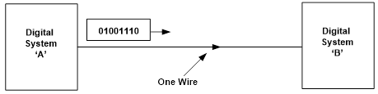
Revision of Computer Bus Structure
Representation of SERIAL transmission of data. Obviously, only one wire is required for serial transmission, the bits of information being sent down the line consecutively.
Serial data transmission

Slide 6
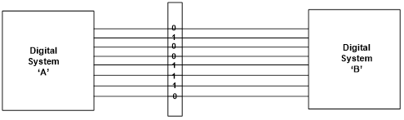
Revision of Computer Bus Structure
An alternative method of conveying digital information is by PARALLEL transmission. Here several wires are used so that an equivalent number of bits of information can be transmitted simultaneously as shown.
Parallel transmission

Slide 7
Revision of Computer Bus Structure
DATA BUS
Processed information i.e. data, data memory is determined by the amount of data a microprocessor processes at once i.e. the no of bit it processed once.
A group of 8 bits is called “Byte”
A group of 4 bits is called “Nibble”

Slide 8
Revision of Computer Bus Structure
For example
A 64KB microprocessor.
64K means that the microprocessor has 64 memory location i.e. Address locations
The byte (B) means that each of the 64 memory location can process 8 bits once

Slide 9
Revision of Computer Bus Structure
CONTROL BUS/LOGIC
This generates control signals and coordinates all the activities to make sure operations are done normally by sending information or signal through the control bus.
Every processor comes with a crystal oscillator i.e. a signal built on a crystal.

Slide 10
Revision of Computer Bus Structure
Signal generators Limitations are
Unstable at high frequency except crystal oscillator. This oscillator generate stable high frequency signals
Clock signals used by the control logic to coordinates its activities. Since the frequency is inversely proportional to the period, we talk about frequency in microprocessor.

Slide 11
Revision of Computer Bus Structure
Address Bus gives the memory capacity of the processor.
The maximum no of address is given as 2^{n}
where n is the no of bits.
2¹⁶ = 2¹⁰ X 2¹⁶ = 2⁶ X 1K = 64K

Slide 12
NOTE
Programming a memory chip mean to store information or data into it.

Slide 13
Focus
Assembly-, Machine-, and High-Level Languages
Assembly Language Programming Tools
Programmer’s View of a Computer System
Basic Computer Organization

Slide 14
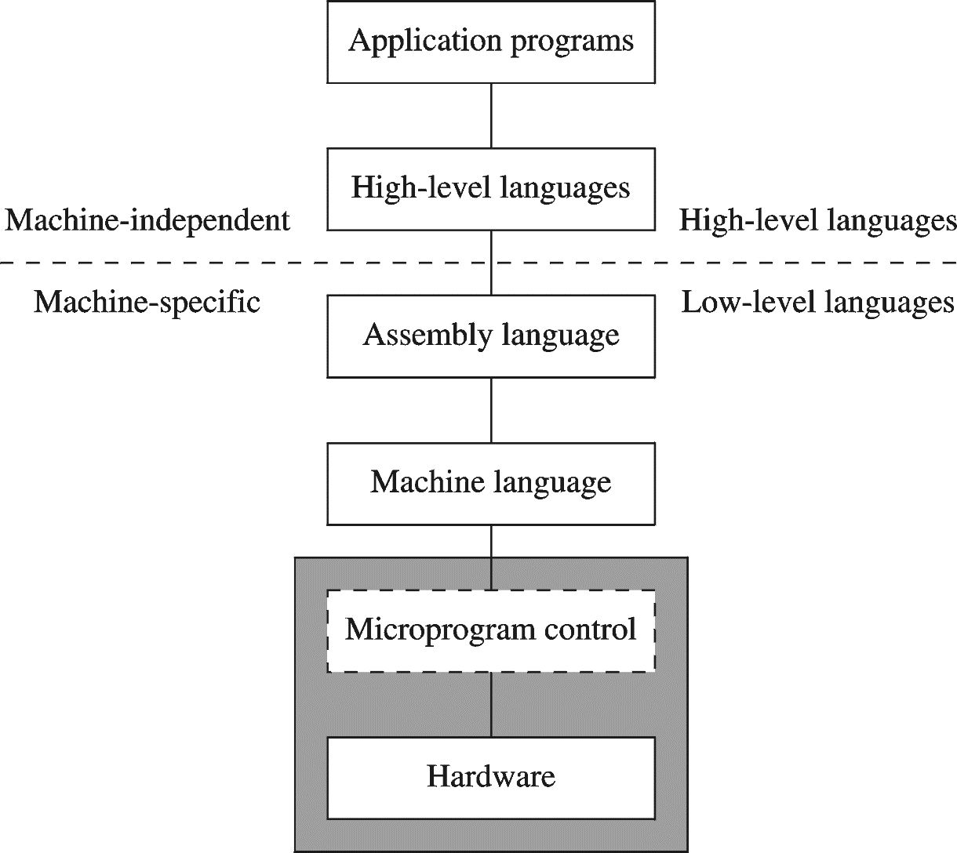
A HIERARCHY OF LANGUAGES

Slide 15
ASSEMBLY AND MACHINE LANGUAGE
Machine language
Native to a processor: executed directly by hardware
Instructions consist of binary code: 1s and 0s
Assembly language
A programming language that uses symbolic names to represent operations, registers and memory locations.
Slightly higher-level language
Readability of instructions is better than machine language
One-to-one correspondence with machine language instructions
Assemblers translate assembly to machine code
Compilers translate high-level programs to machine code
Either directly, or
Indirectly via an assembler

Slide 16
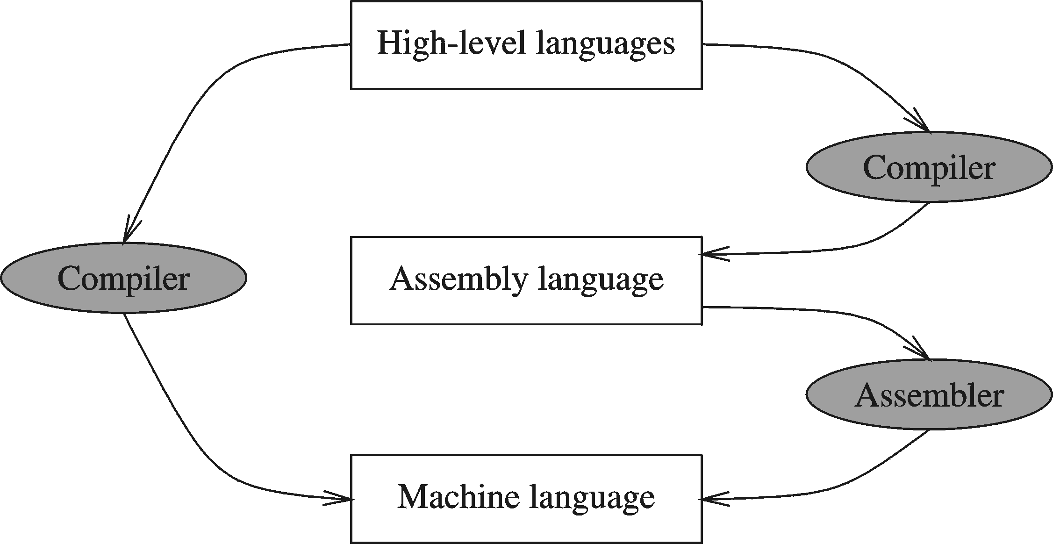
COMPILER AND ASSEMBLER

Slide 17
INSTRUCTIONS AND MACHINE LANGUAGE
Each command of a program is called an instruction (it instructs the computer what to do).
Computers only deal with binary data, hence the instructions must be in binary format (0s and 1s) .
The set of all instructions (in binary form) makes up the computer's machine language. This is also referred to as the instruction set.

Slide 18
INSTRUCTION FIELDS
Machine language instructions usually are made up of several fields. Each field specifies different information for the computer. The major two fields are:
Opcode field which stands for operation code and it specifies the particular operation that is to be performed.
Each operation has its unique opcode.
Operands fields which specify where to get the source and destination operands for the operation specified by the opcode.
The source/destination of operands can be a constant, the memory or one of the general-purpose registers.

Slide 19
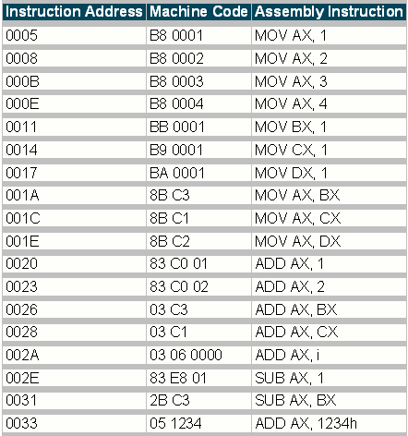
ASSEMBLY VS. MACHINE CODE

Slide 20
TRANSLATING LANGUAGES
English: D is assigned the sum of A times B plus 10.
High-Level Language: D = A * B + 10
A statement in a high-level language is translated typically into several machine-level instructions
Intel Assembly Language:
mov eax, A
mul B
add eax, 10
mov D, eax
Intel Machine Language:
A1 00404000
F7 25 00404004
83 C0 0A
A3 00404008

Slide 21
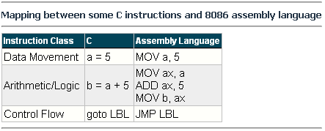
MAPPING BETWEEN ASSEMBLY LANGUAGE AND HLL
Translating HLL programs to machine language programs is not a one-to-one mapping
A HLL instruction (usually called a statement) will be translated to one or more machine language instructions

Slide 22
ADVANTAGES OF HIGH-LEVEL LANGUAGES
Program development is faster
High-level statements: fewer instructions to code
Program maintenance is easier
For the same above reasons
Programs are portable
Contain few machine-dependent details
Can be used with little or no modifications on different machines
Compiler translates to the target machine language
However, Assembly language programs are not portable

Slide 23
WHY ASSEMBLY LANGUAGE?
Accessibility to system hardware
Assembly Language is useful for implementing system software
Also useful for small embedded system applications
Space and Time efficiency
Understanding sources of program inefficiency
Tuning program performance
Writing compact code
Writing assembly programs gives the computer designer the needed deep understanding of the instruction set and how to design one
To be able to write compilers for HLLs, we need to be expert with the machine language. Assembly programming provides this experience

Slide 24
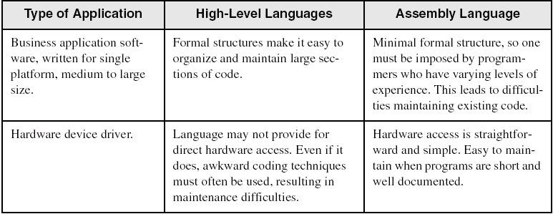
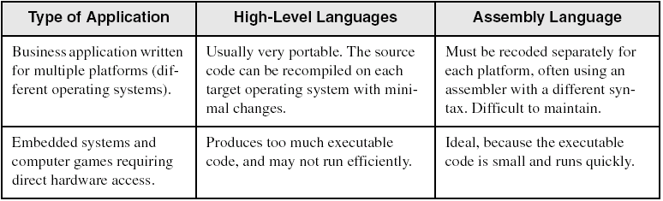
ASSEMBLY VS. HIGH-LEVEL LANGUAGES

Slide 25
ASSEMBLER
Software tools are needed for editing, assembling, linking, and debugging assembly language programs
An assembler is a program that converts source-code programs written in assembly language into object files in machine language
Popular assemblers have emerged over the years for the Intel family of processors. These include …
TASM (Turbo Assembler from Borland)
NASM (Netwide Assembler for both Windows and Linux), and
GNU assembler distributed by the free software foundation

Slide 26
LINKER AND LINK LIBRARIES
You need a linker program to produce executable files
It combines your program's object file created by the assembler with other object files and link libraries, and produces a single executable program
LINK32.EXE is the linker program provided with the MASM distribution for linking 32-bit programs
We will also use a link library for input and output
Called Irvine32.lib developed by Kip Irvine
Works in Win32 console mode under MS-Windows

Slide 27
ASSEMBLE AND LINK PROCESS
A project may consist of multiple source files
Assembler translates each source file separately into an object file
Linker links all object files together with link libraries
Source
File
Assembler
Object
File
Source
File
Assembler
Object
File
Linker
Executable
File
Source
File
Assembler
Object
File
Link
Libraries

Slide 28
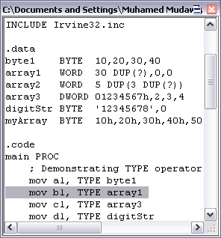
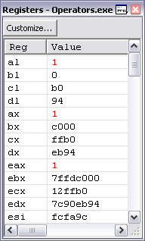
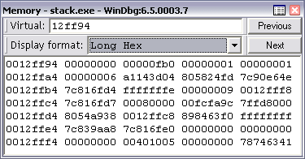
DEBUGGER
Allows you to trace the execution of a program
Allows you to view code, memory, registers, etc.
Example: 32-bit Windows debugger

Slide 29
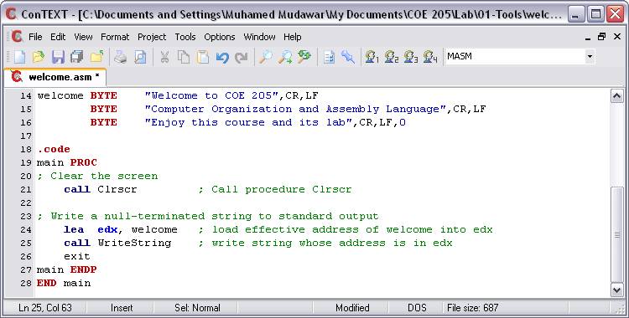
EDITOR
Allows you to create assembly language source files
Some editors provide syntax highlighting features and can be customized as a programming environment

Slide 30
PROGRAMMER’S VIEW OF A COMPUTER SYSTEM
Increased level of abstraction
Application Programs
High-Level Language
Level 5
Assembly Language
Level 4
Operating System
Level 3
Instruction Set
Architecture
Level 2
Microarchitecture
Level 1
Each level hides the details of the level below it
Digital Logic
Level 0

Slide 31
PROGRAMMER'S VIEW
Application Programs (Level 5)
Written in high-level programming languages
Such as Java, C++, Pascal, Visual Basic . . .
Programs compile into assembly language level (Level 4)
Assembly Language (Level 4)
Instruction mnemonics are used
Have one-to-one correspondence to machine language
Calls functions written at the operating system level (Level 3)
Programs are translated into machine language (Level 2)
Operating System (Level 3)
Provides services to level 4 and 5 programs
Translated to run at the machine instruction level (Level 2)

Slide 32
PROGRAMMER'S VIEW
Instruction Set Architecture (Level 2)
Specifies how a processor functions
Machine instructions, registers, and memory are exposed
Machine language is executed by Level 1 (microarchitecture)
Microarchitecture (Level 1)
Controls the execution of machine instructions (Level 2)
Implemented by digital logic (Level 0)
Digital Logic (Level 0)
Implements the microarchitecture
Uses digital logic gates
Logic gates are implemented using transistors

Slide 33
INSTRUCTION SET ARCHITECTURE (ISA)
Collection of assembly/machine instruction set of the machine
Machine resources that can be managed with these instructions
Memory
Programmer-accessible registers.
Provides a hardware/software interface

Slide 34
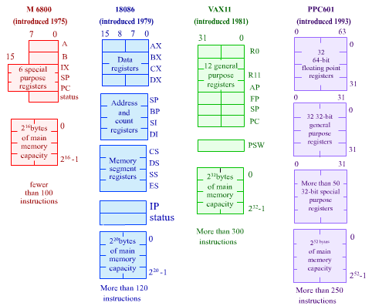
INSTRUCTION SET ARCHITECTURE (ISA)

Slide 35
CPU MEMORY INTERFACE
Address Bus
Memory address is put on address bus
If memory address = m bits then 2^{m} locations are addressed
Data Bus: b-bit bi-directional bus
Data can be transferred in both directions on the data bus
Note that b is not necessary equal to w or s. So data transfers might take more than a single cycle (if w > b) .
Control Bus
Signals control
transfer of data
Read request
Write request
Complete transfer

Slide 36
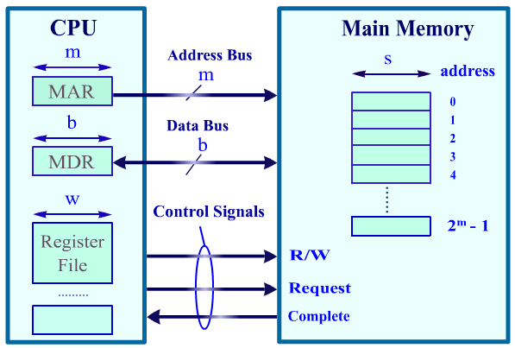
CPU MEMORY INTERFACE

Slide 37
MEMORY DEVICES
ROM (Read-Only-Memory)
A read-only-memory, non-volatile i.e. stores information permanently
Has random access of stored information
Used to store the information required to startup the computer
Many types: ROM, EPROM, EEPROM, and FLASH
FLASH memory can be erased electrically in blocks
Cache
A very fast type of RAM that is used to store information that is most frequently or recently used by the computer
Recent computers have 2-levels of cache; the first level is faster but smaller in size (usually called internal cache), and the second level is slower but larger in size (external cache).

Slide 38
The Need for a Memory Hierarchy
Widening (expand) speed gap between CPU and main memory
Processor operation takes less than 1 ns
Main memory requires more than 50 ns to access
Each instruction involves at least one memory access
One memory access to fetch the instruction
Additional memory accesses for instructions involving memory data access
Memory bandwidth limits the instruction execution rate
Cache memory can help bridge the CPU-memory gap
Cache memory is small in size but fast

Slide 39
PROCESSOR-MEMORY PERFORMANCE GAP
1980 – No cache in microprocessor
1995 – Two-level cache on microprocessor
CPU: 55% per year
1000
“Moore’s Law”
100
Processor-Memory
Performance Gap: (grows 50% per year)
Performance
10
DRAM: 7% per year
1
1981
1982
1983
1984
1985
1986
1987
1988
1989
1990
1991
1992
1993
1994
1995
1996
1997
1998
1980
1999
2000

Slide 40
Typical Memory Hierarchy
Registers are at the top of the hierarchy
Typical size < 1 KB
Access time < 0.5 ns
Level 1 Cache (8 – 64 KB)
Access time: 0.5 – 1 ns
L2 Cache (512KB – 8MB)
Access time: 2 – 10 ns
Main Memory (1 – 2 GB)
Access time: 50 – 70 ns
Disk Storage (> 200 GB)
Access time: milliseconds

Slide 41
Typical Memory Hierarchy
Microprocessor
Registers
L1 Cache
L2 Cache
Faster
Memory Bus
Bigger
Memory
I/O Bus
Disk, Tape, etc

Slide 42
MAGNETIC DISK STORAGE
Read/write head
Sector
Actuator
Recording area
Track 2
Track 1
Track 0
Arm
Direction of rotation
Platter
Spindle

Slide 43
MAGNETIC DISK STORAGE
Disk Access Time = Seek Time + Rotation Latency + Transfer Time
Seek Time: head movement to the desired track (milliseconds)
Rotation Latency: disk rotation until desired sector arrives under the head
Transfer Time: to transfer data

Slide 44
Example on Disk Access Time
Given a magnetic disk with the following properties
Rotation speed = 7200 RPM (rotations per minute)
Average seek = 8 ms, Sector = 512 bytes, Track = 200 sectors
Calculate
Time of one rotation (in milliseconds)
Average time to access a block of 32 consecutive sectors

Slide 45
Example on Disk Access Time
Given a magnetic disk with the following properties
Rotation speed = 7200 RPM (rotations per minute)
Average seek = 8 ms, Sector = 512 bytes, Track = 200 sectors
Calculate
Time of one rotation (in milliseconds)
Average time to access a block of 32 consecutive sectors
Answer
Rotations per second
Rotation time in milliseconds
Average rotational latency
Time to transfer 32 sectors
Average access time
= 7200/60 = 120 RPS
= 1000/120 = 8.33 ms
= time of half rotation = 4.17 ms
= (32/200) * 8.33 = 1.33 ms
= 8 + 4.17 + 1.33 = 13.5 ms

Slide 46


